Slide 1




Towards Energy-efficient Federated Learning via INT8-based Training on Mobile DSPs
Proceedings of the 33rd ACM Web Conference 2024
Jinliang Yuan, Shangguang Wang, Hongyu Li, Daliang Xu, yuanchun Li, Mengwei Xu, Xuanzhe Liu
Beijing University of Posts and
Telecommunications
Tsinghua University
Peking University
Notes:
Our work is … This is done by BUPT, PKU, and THU.

Slide 2




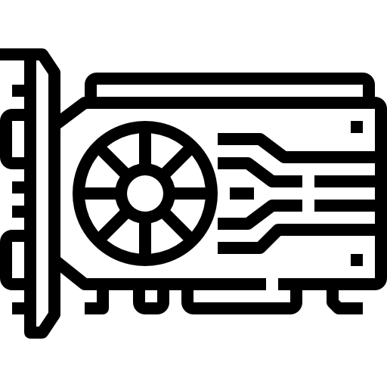
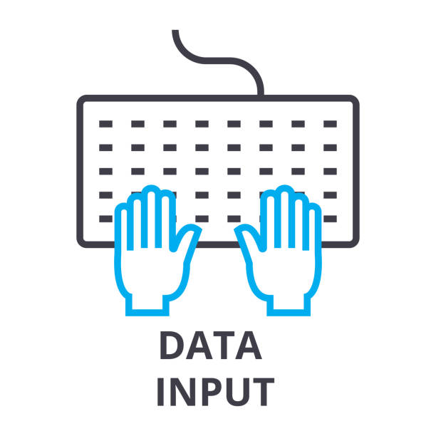



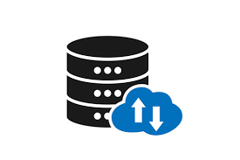







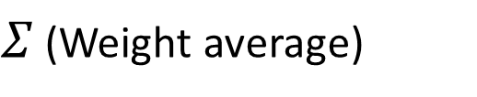
AI-driven
Web Applications
Federated Learning Algorithm
History
suggestions
$Σ$ (Weight average)
Page
recommend
Private data
Model update
ΔW
Input
prediction
Global model
Locally train
Vicious
prediction
Strict protect
ΔW
ΔW
High accuracy
Keep private data locally
Train the model
Upload ΔW
Download global model
Private user data
ΔW
ΔW

Slide 3
AI-driven
Web Applications
Federated Learning Algorithm
History
suggestions
Page
recommend
ΔW
ΔW
Input
prediction
Strict protect
ΔW
ΔW
Vicious
prediction
High accuracy
Keep private data locally
Train the model
Upload ΔW
Download global model
Private user data
Notes:
A colossal amount of date are generated in the smart devices, Harnessing such data is vital to the success of the AI-driven web applications
Federated Learning Algorithm can help with this
It does not upload the private user data to the global server.
Instead, it keep the data locally.
The global server aggregates the model weights update

Slide 4
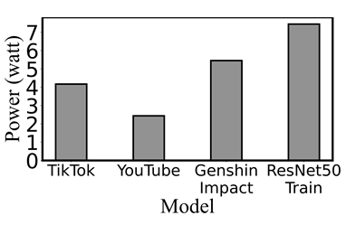



Is Federated Learning Algorithm enough to protect data?
No! The energy is the main fence.
Such huge energy is unacceptable.
E(Training VGG16 on CIFAR-10) = E(Watch TikTok/YouTube for 12/24 hours) = E(Play video game for 9 hours)
Notes:
For example, our preliminary experiment of FL training with VGG-
16 on CIFAR-10 consumes power 42.5 kJ for each participant device,
which equals watching a YouTube 1080p video on a smartphone
for about 24 hours.

Slide 5
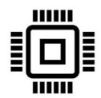
Why energy consumption is so huge?
DNN models are trained on GPUs
For phones, they need executing on CPUs
floating computation
matrix manipulation
integer computation
general computing
Notes:
DNN Models mostly are trained in the GPUs which optimize for floating computation and matrix manipulation.
For the Mobiles, they needs to use CPU for computing which focus on the general computing and lacks of optimization for floating and matrixes.
Thus CPU mismatches the DNN models.

Slide 6

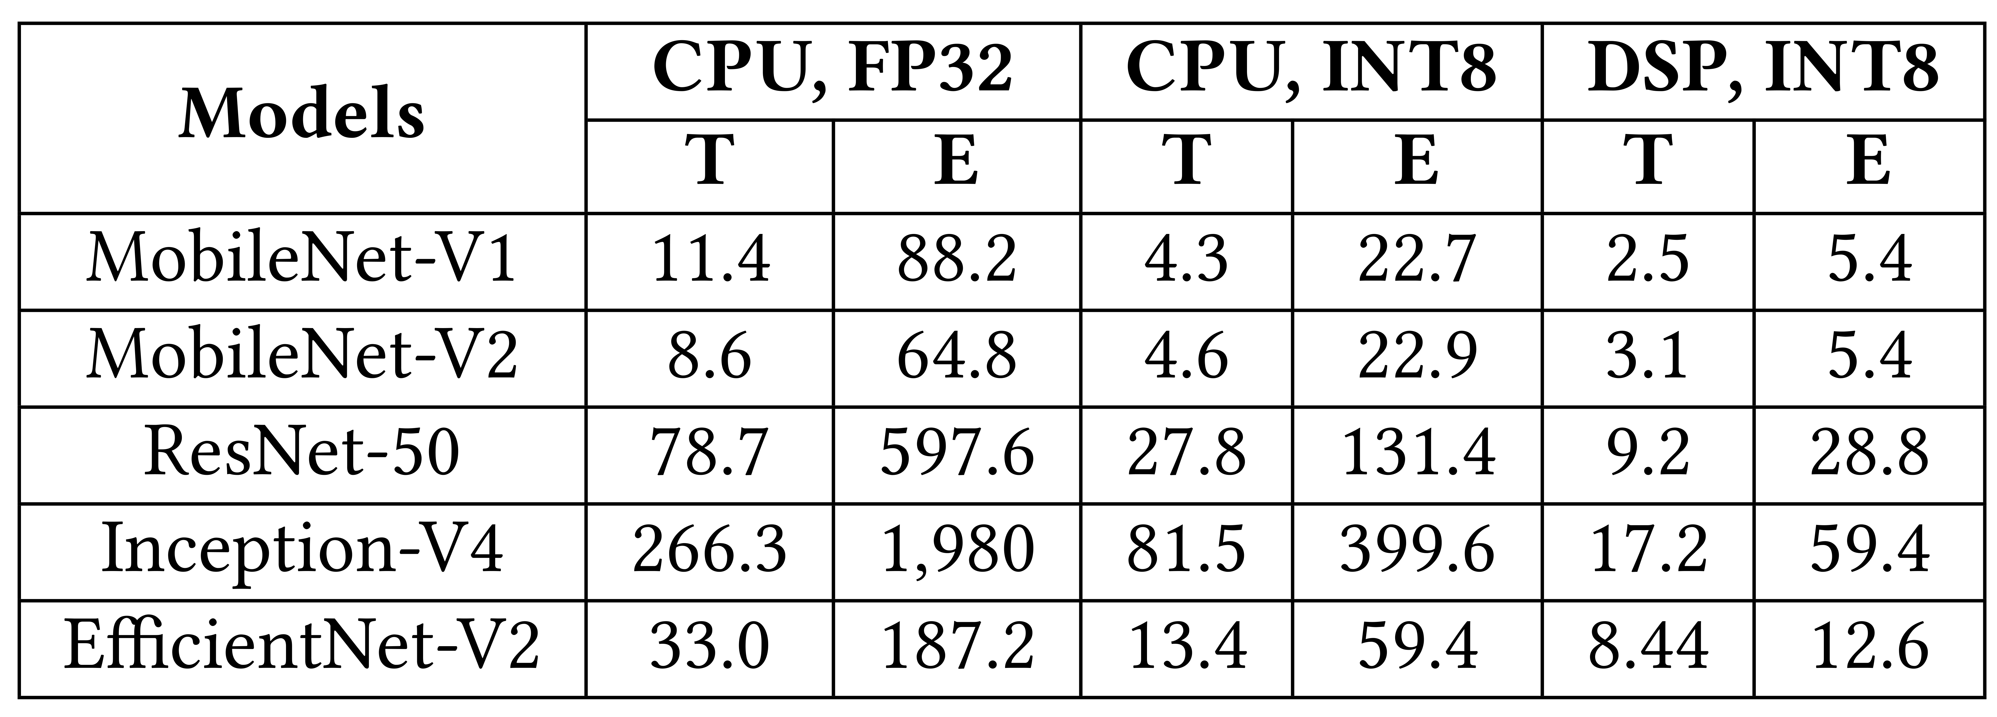
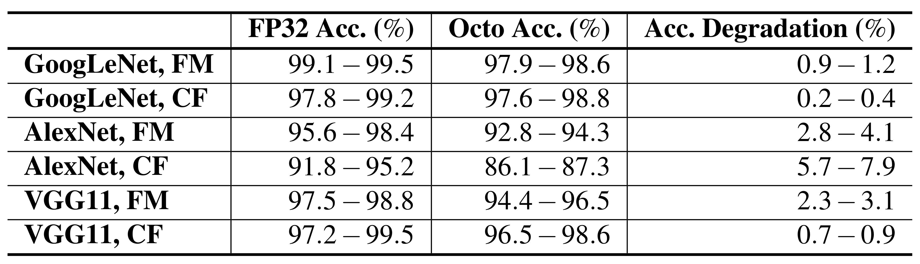
Is there a one-size-fits-all model on mobile device?
We observe there is DSP on the phone
It’s energy friendly and can handle matrix manipulation
Save energy 32X, speeds up 9X
Accuracy losses only 2%
Notes:
DSP can save energy 32 times and save time 9 times than the cpu.
While it only losses the accuracy for only 2 pertantage.

Slide 7
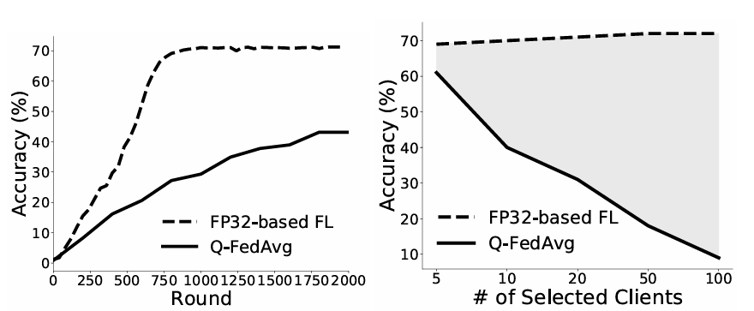
Is there a one-size-fits-all model on mobile device?
Challenge: Directly using DSP with FL is impractical
Low and slow convergence
Low scalability
GOAL: How to design an energy efficient and high accuracy algorithm with DSP?
Notes:
However, directly using DSP to implement with FL is impractical. It will low and slow convergence compared with FP32-based FL.
This is because DSP is designed for integer and federated learning is for floating computation.

Slide 8
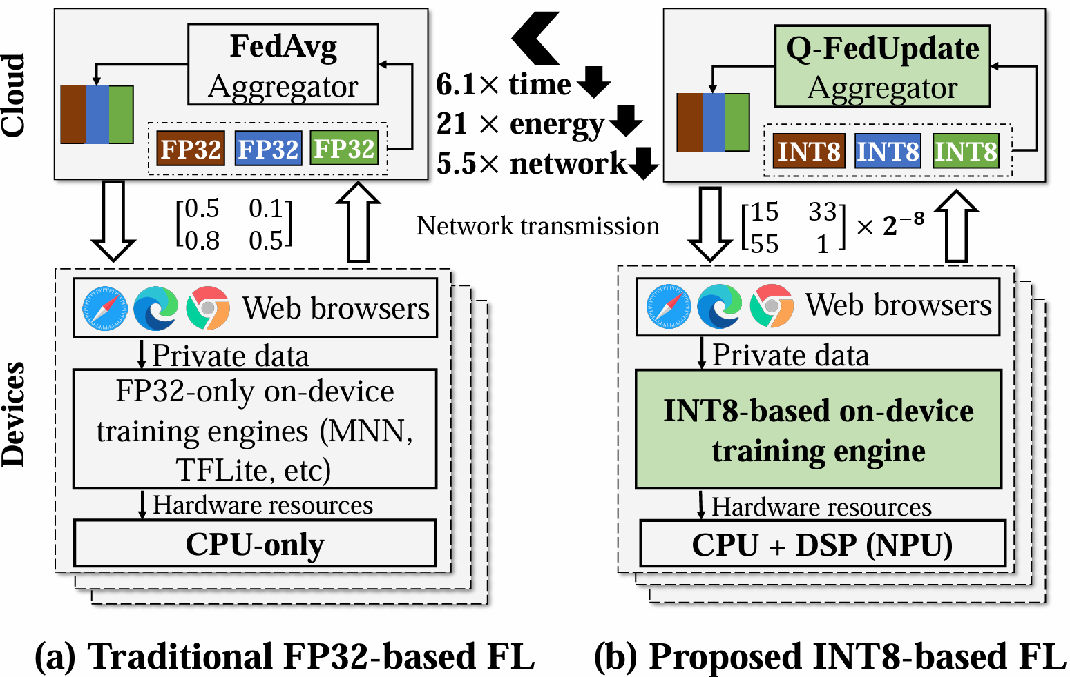
Key Idea: FP32-INT8
Notes:
The key idea of our paper is to replace the fp32 with int8

Slide 9
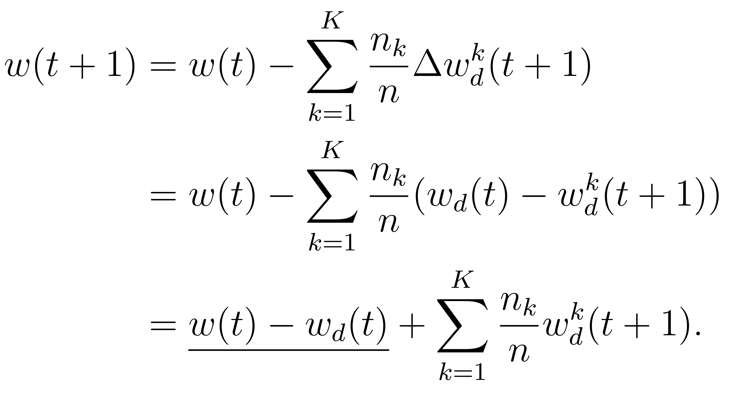
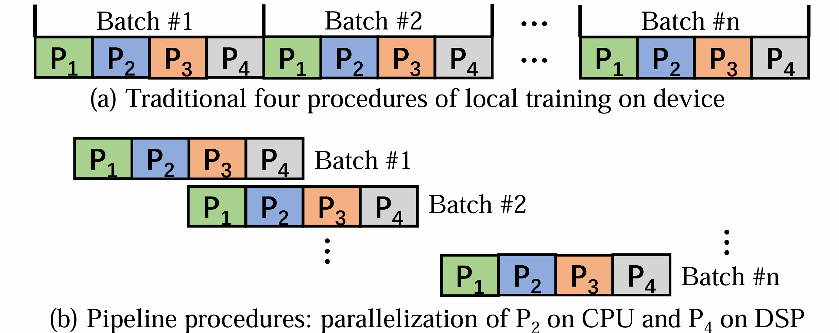
Is there a one-size-fits-all model on mobile device?
Design1:
Error-Compensated Aggregation
Quantization Error
Q-FedAvg
Design2:
Pipelined Batch Quantization

Slide 10
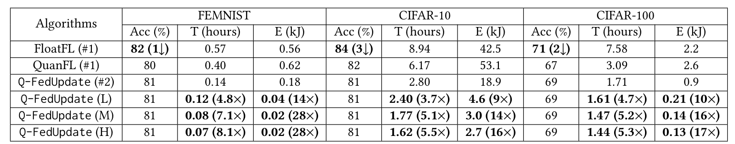
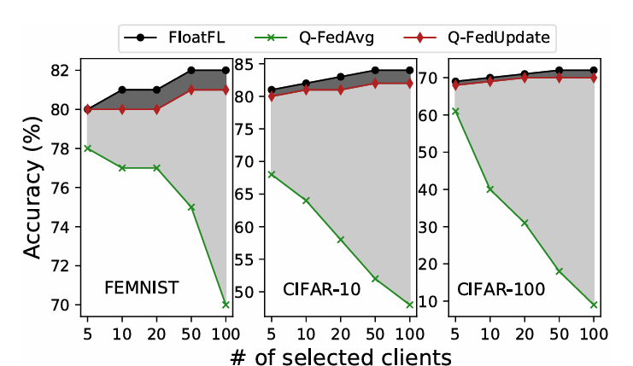
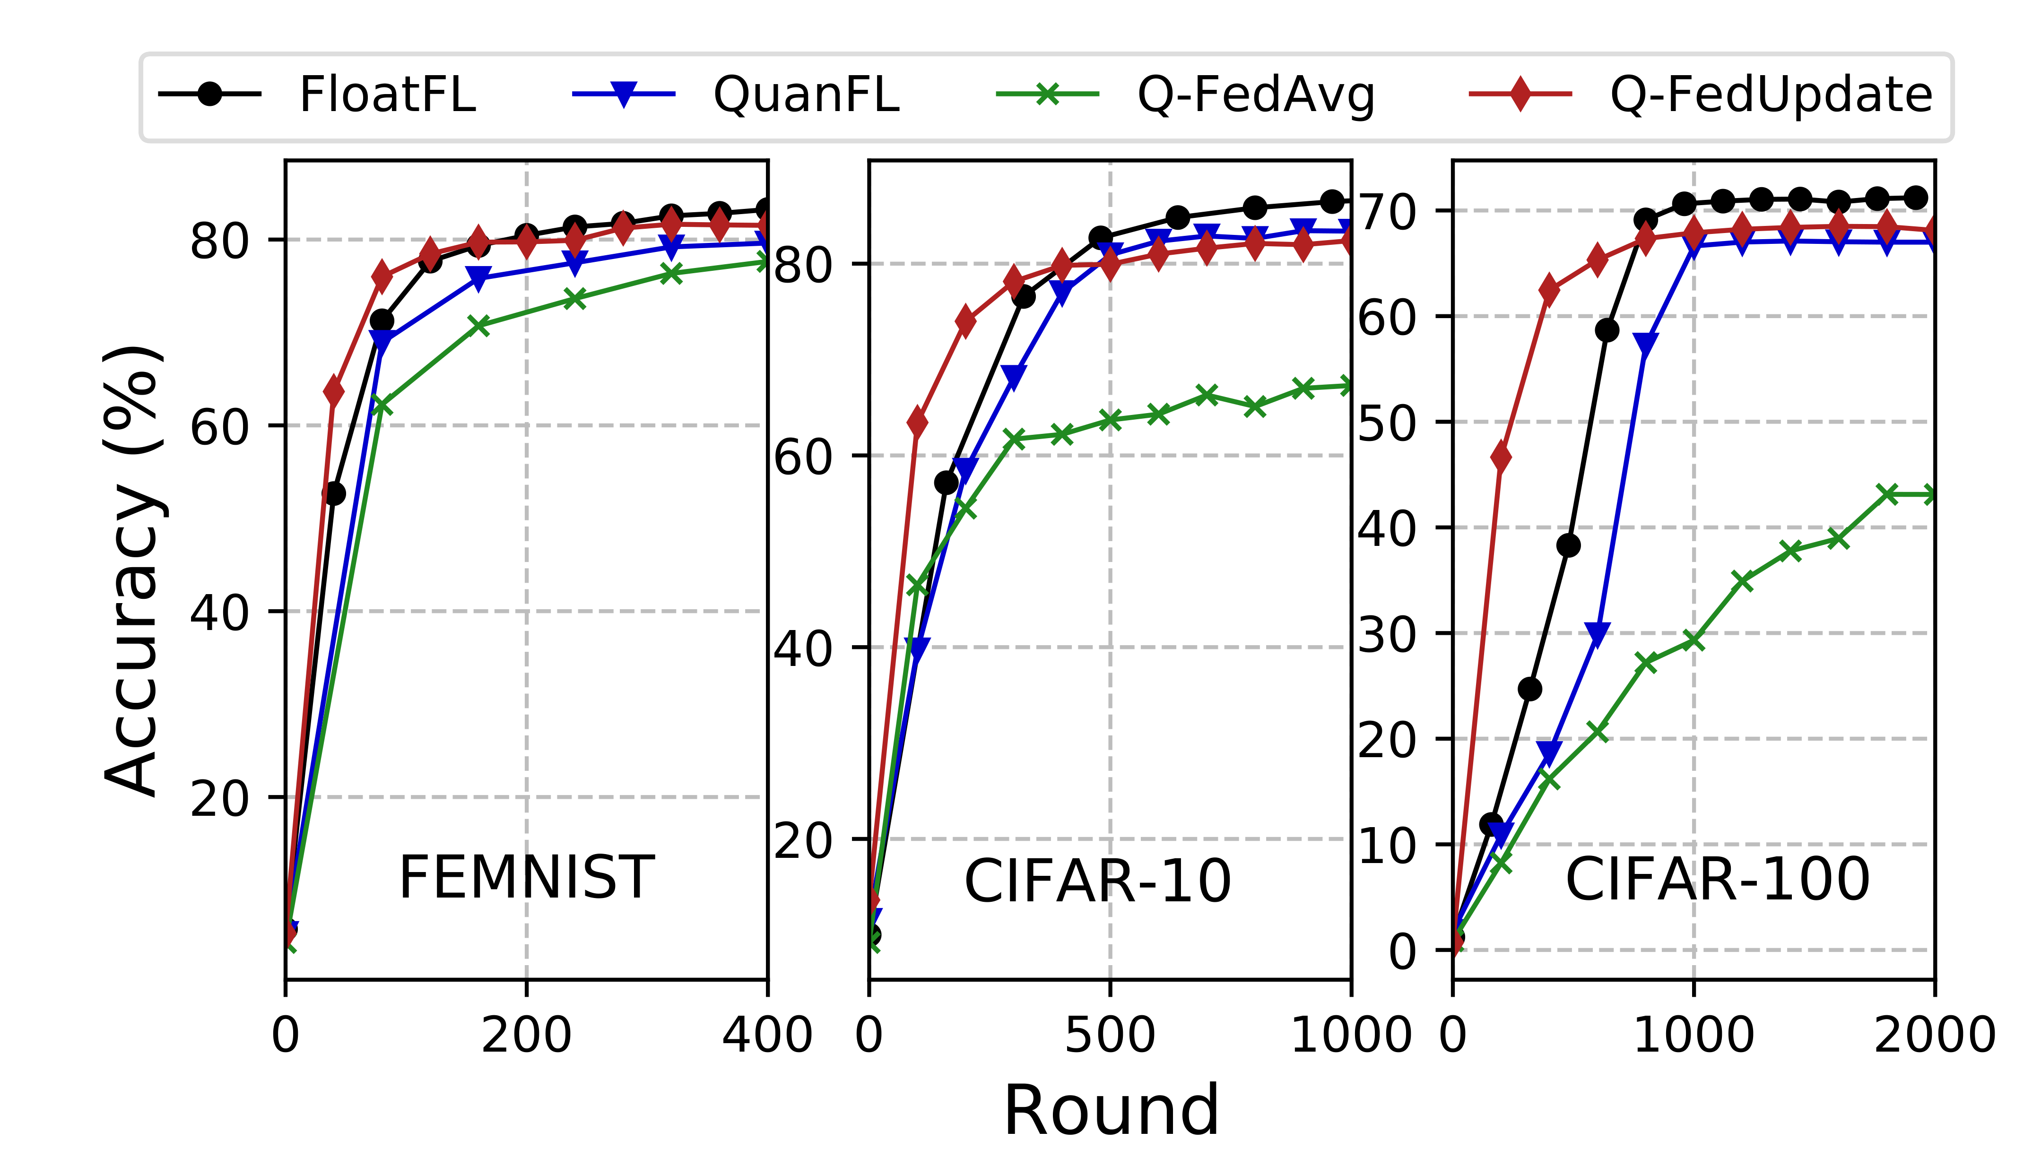
Evaluation Results
Time speeds up 6x
Energy saves 21X
Accuracy losses only 2%

Slide 11
Thanks
Q&A

